Slide 1
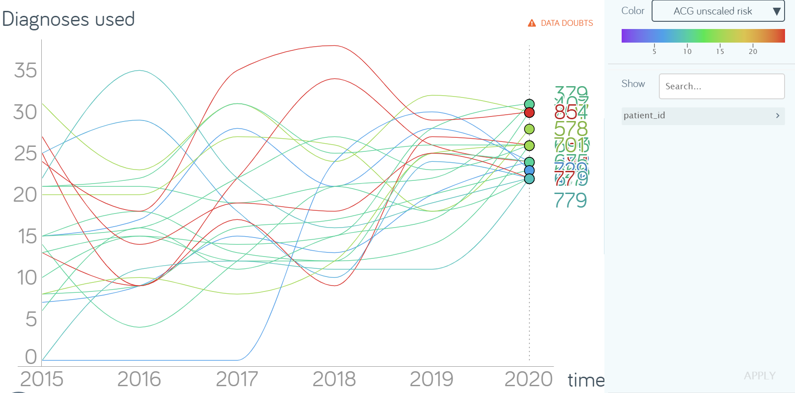


Elucidating patterns of multimorbidity among patients with ambiguous diagnoses
– the case of Myalgic Encephalomyelitis/Chronic Fatigue Syndrome
Björn Bragée, MD; Lennart Carlsson, MSc, MPH, PhD; Bo Christer Bertilson, MD, PhD
Conclusions and implications
This study illustrates the complexity of the pattern of multimorbidity over time, depicting overlapping diagnoses.
The analyses of the trajectories of the various patterns of multimorbidity might pave the way for a broader understanding of triggers for more complex health conditions as ME/CFS.
The drive towards patient-centered care may lead to a more holistic view to help patients with ambiguous states to cope with their situation.
Objectives: To elucidate, analyze and visualize patterns of clusters of diagnoses over time among patients having been diagnosed with ME/CFS. Thereby, possibly, contribute to the complex pathophysiology of ME/CFS.
Methods: A retrospective register-based cohort study with 549 patients during year 2015-2020 in Region Stockholm, Sweden. Diagnoses were processed by the Adjusted Clinical Groups© case-mix system from Johns Hopkins University. Visualization by “Gapminder” software.
Results: The last year, half of all patients had received more than eight, and some up to 32 diagnoses. Most frequent diagnosis clusters were “General Signs and Symptoms”, “Musculoskeletal”, “Psychosocial” and “Neurologic”. Throughout the years, most clusters indicated ambiguous states. However, the number of patients with psychiatric or psychosomatic disorders and with musculoskeletal symptoms seemed to diminish when ME/CFS diagnoses were registered.
Trajectories of 22 patients with 22 diagnosis or more.
Combinations of number of diagnoses and ACG risk score. Visualization over time by “Gapminder” software.
TAKE-HOME-MESSAGES
Multimorbidity means overlapping diseases – at the societal level. In person-centered care however, diseases not just overlap – they interact.
To explore multimorbidity at the individual level it is needed to realize that the changing of the health status is ever ongoing.
The health situation of a patient with ambiguous diseases can be explored by aggregating medical data from the past.
From disease focus to patient orientation
From static to dynamic perspective
Karolinska Institutet
Dep of Neurobiology, Care Sciences and Society
Div of Family Medicine and Primary Care
lennart.carlsson@ki.se
bjorn.bragee@ki.se
bo.bertilson@ki.se
Bragée Clinics
Karlavägen 100, Stockholm
Commisioned by Stockholm Region
Björn Bragée, spec. in pain medicine, MD
bjorn@bragee.se
FORGET-ME-NOT is the flower used as a symbol of ME/CFS.
In our study 85% were female and 21 patients below 20 years (4%).

